Slide 1
INGI2145: CLOUD COMPUTING (Fall 2014)
Web Programming 2
27 November 2014
Lecture slides adapted from Upenn NETS212 by A. Haeberlen, Z. Ives Reproduced with permission

Slide 2
Goals for today
Brief introduction to JavaScript
Event handlers
Accessing the DOM
The XMLHttpRequest object
AJAX
Putting everything together
Example: Search suggestions
Simplifying things
jQuery support for AJAX
JSON
Using external elements
Example: Google Maps
NEXT

Slide 3
What is JavaScript?
A script language for web browsers
Runs directly in the browser → can respond to user interactions quickly, without wide-area latencies
Can interact with web pages through the DOM
Syntax very similar to Java
Similar operators, constructs, naming conventions...
This is intentional
But very different from Java 'under the hood'
Dynamic typing, no inheritance, runtime evaluation...
Details can be a bit messy

Slide 4
A brief history of JavaScript
Developed at Netscape (1995)
Author: Brendan Eich
Originally called 'Mocha', then 'LiveScript'
Became 'JavaScript' when Netscape and Sun got together
NO direct connection to Java!
Microsoft's dialect: JScript (1996)
To avoid licensing issues
Standardized as ECMAscript (1997)
History of incompatibilities across browsers
Example: Different ways of getting XMLHttpRequest object in different browsers (see later)

Slide 5
A simple client-side example
<html>
<head><title>Test</title></head>
<script type="text/javascript">
<!--
function check(myform) {
if (myform.term.value=="") {
alert("Please enter a search term!");
return false;
} else {
return true;
}
} // -->
</script>
<body>
<h1>Input a search term</h1>
<form method="post" action="process.php" onsubmit="return check(this)">
<input type="text" name="term" size="20">
<input type="submit" value="Search">
</form>
</body>
</html>
Prevents problems if browser does not support scripting
Script is embedded in the web page
Calls function when form is submitted; aborts submission when function returns false
Example: Form validation
Warns the user if no search term is specified

Slide 6
Including JavaScript in HTML
Option #1: Embed entirely in HTML document
As in previous example: Use <script>...</script>
To be safe, enclose script in HTML comments (to avoid confusing browsers that don't recognize JavaScript)
Option #2: Attach as a separate file
<script type="text/javascript" src="myscript.js"> </script>
Some browsers need the space between <script>...</script> and don't load the script if this is omitted
Remember that script is visible to the client!
Do NOT hardcode any passwords or include any secrets

Slide 7
Event handlers
Client-side JS can react to various events
Examples: User clicks on an element or presses a key, user submits a form, user changes a selection in a form, page finishes loading, mouse moves over a certain element...
Web page can request that the browser call a certain JavaScript function when the event occurs
Events can be requested from the web page:
<a href="foo.html" onClick="alert('You\'ve clicked!')">
... or directly from JavaScript:
theElement.onclick = functionName (DOM 0)
theElement.addEventListener(type, function, opt)

Slide 8
Manipulating HTML (XML) documents
Typical tasks:
Restructure a HTML document
Add/remove/modify elements
Retrieve certain elements that satisfy some constraint
How do we do this in a program?
Need an interface that allows programs and scripts to dynamically access and update the content, structure, and style of documents
Solution: The Document Object Model (DOM)

Slide 9

The Document Object Model
root
attribute
Root
p-i
element
?xml
dblp
text
mastersthesis
article
XML document
mdate
mdate
key
key
2002…
author
title
year
school
editor
title
journal
volume
year
ee
ee
XML parser
1992
2002…
ms/Brown92
tr/dec/…
The…
1997
PRPL…
Digital…
db/labs/dec
Kurt P….
Univ….
Paul R.
SRC…
http://www.
Document components represented by objects
Objects have methods like getFirstChild(), getNextSibling()... → can be used to traverse the tree
Can also modify the tree, and thus alter the document, via insertAfter(), etc.

Slide 10
Accessing the DOM from JavaScript
<html>
<head><title>Test</title></head>
<script type="text/javascript">
<!--
function replace() {
var t = document.getElementById('abc').value;
document.getElementById('xyz').innerHTML = t;
} // -->
</script>
<body>
<h1>Test</h1>
<form action="xyz" method="get" onSubmit="replace(); return false">
<input type="text" name="thetext" size="20" id="abc">
<input type="submit" value="Replace">
</form>
<div id="xyz">(this is where the text will go)</div>
</body>
</html>
Reads current contents of input field
Replaces the text in the 'div' element below
JavaScript programs can interact with the DOM
Document root provided as the 'document' object
Read from, and write to, elements in the DOM tree
How do we find the right element in the tree?

Slide 11
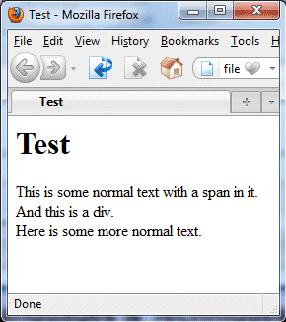
<div> and <span>
<html>
<head><title>Test</title></head>
<body>
<h1>Test</h1>
This is some normal text with
a <span id="foo">span</span> in it.
<div id="bar">And this is a div.</div>
Here is some more normal text.
</html>
No effect on rendering
... document.getElementById('foo').innerHTML = "<p>Some text</p>"; ...
Primary use is to hold an identifier
We can use this identifier to find the element in the DOM
Otherwise, the elements do very little; <div> is rendered similar to <p>, and <span> does not affect text flow at all
Other elements can hold 'id' too, but have other functions

Slide 12
Functions for accessing the DOM
The HTML page itself is called 'document'
To get information from the document:
var price = document.getElementById('price').value;
var allimages = document.getElementsByName('img');
var firstimg = document.getElementsByName('img')[0];
To put information into the document:
Create new elements; replace, or append to, existing nodes
// Find thing to be replaced var mainDiv = document.getElementById("main-page"); var orderForm = document.getElementById("target"); // Create replacement var paragraph = document.createElement("p"); var text = document.createTextNode("Here is the new text."); paragraph.appendChild(text); // Do the replacement mainDiv.replaceChild(paragraph, target);

Slide 13
innerHTML
Building new DOM subtree is a lot of work
Isn't there an easier way?
Solution: innerHTML
A non-W3C DOM property that gets or sets the text between the start and end tags
Argument completely replaces elements' existing content
If the new value contains HTML tags, it is parsed and formatted before being placed into the document
Example:
document.getElementById('foo').innerHTML="<p>XYZ</p>"

Slide 14
Recap: JavaScript
A scripting language for browsers
Can make pages interactive w/o sending requests to server
Syntax is very similar to Java, but internals are very different
Lots of small differences between browser implementations
JavaScript can interact with the DOM
Examples: Read data from forms, replace parts of the page
Can register event handlers with DOM elements to respond to clicks, keypresses, mouse movements, selections...

Slide 15

Goals for today
Brief introduction to JavaScript
Event handlers
Accessing the DOM
The XMLHttpRequest object
AJAX
Putting everything together
Example: Search suggestions
Simplifying things
jQuery support for AJAX
JSON
Using external elements
Example: Google Maps
NEXT

Slide 16
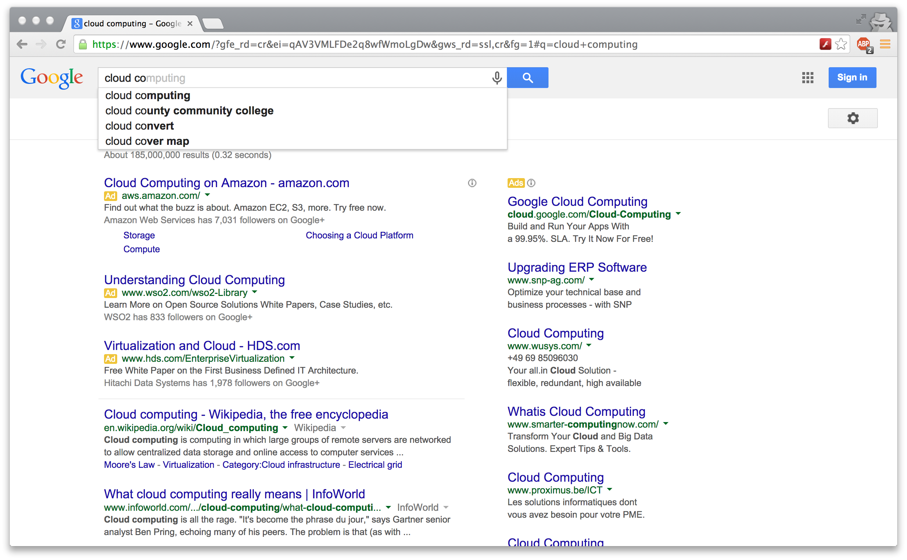
Implementing search suggestions
How would you do this with pure JavaScript?

Slide 17
XMLHttpRequest
A JavaScript object that enables web pages to dynamically load more content
Example: Ask the server for search suggestions while the user is typing the search term
Request can be asynchronous
Browser performs the HTTP request in the background while the user continues to interact with the web page
Script defines a callback function that should be invoked when the requested content has arrived
Content does not have to be XML
But often is

Slide 18
XMLHttpRequest workflow
Instantiate a new XMLHttpRequest object
Prepare the object
Call open() to set the URL and the method (GET, POST, ...)
Can add headers, HTTP authentication, ...
Need to send a callback function that will be called by the browser when the results are available
Send the request
Invoke send(), optionally with data to submit (for POST)
Handle invocations of the callback function
Do something with the response if request was successful
Optionally, handle errors

Slide 19
XMLHttpRequest properties
Property | Description
readyState | Current state of the object: 0 = UNSENT (before open() is called) 1 = OPENED (before send() is called) 2 = HEADERS_RECEIVED (header+status available) 3 = LOADING (partial data available) 4 = DONE (operation complete)
onreadystatechange | Can be assigned a function that is called whenever readyState changes (e.g., to process the response)
responseText | Response as text
responseXML | Response as a DOM document object (parsed as text/xml)
status | Status of the response (a HTTP result code, e.g. 200)
statusText | Response string returned by the server (e.g., '200 OK')

Slide 20
XMLHttpRequest methods
Method | Description
open("method","url" [,asyncFlag[,user[,pwd]]]) | Initializes a new request. Default is asynchronous (asyncFlag=true). Optional HTTP user+password.
setRequestHeader("L","V") | Used to add headers to the request
send([content]) | Sends the request. Content is optional (omitted, e.g., for GET)
abort() | Aborts a request that has already been sent
getResponseHeader("L") | Returns a specific header from the response
getAllResponseHeaders() | Returns all the headers from the response

Slide 21
Security restrictions
Requests are subject to same-origin policy
Can only connect to the domain that also sent the currently loaded page
Example: Page from foo.com can't request content from bar.com
Similar to the restriction that applies to cookies
Some workarounds exist
JSONP: Encode data in a JavaScript
CORS: Additional HTTP header allows access from different domains; part of XMLHttpRequest Level 2
Plugins (Flash, Silverlight, ...)
Bug alert!

Slide 22

Instantiating XMLHttpRequest
Do I really have to worry about this?
var request = null; function getXMLHttpRequest() { try { request = new XMLHttpRequest(); } catch(err1) { try { request = new ActiveXObject("Microsoft.XMLHTTP"); } catch(err2) { try { request = new ActiveXObject("Msxml2.XMLHTTP"); } catch(err3) { request = null; } } }
if (request == null) alert("Error creating request object!"); }
Implementation in browsers varies:
var request = new XMLHttpRequest(); (most browsers)
var request = new ActiveXObject("Microsoft.XMLHTTP");
var request = new ActiveXObject("Msxml2.XMLHTTP");
Using incorrect method causes an exception!

Slide 23
A few caveats
When doing a POST, set the content type
When doing a GET, encode parameters
Not all characters are legal in a URL (example: space)
Need to escape these characters (' ' → '%20' etc.)
Can use the escape() method to do this:
request.setRequestHeader('Content-Type', 'application/x-www-form-urlencoded'); request.send('param1='+param1+'&param2='+param2);
request.send('param1='+escape(param1));

Slide 24
Recap: XMLHttpRequest
XMLHttpRequest is a JavaScript object
Enables web pages to dynamically request more data
For security reasons, same-origin policy applies
Despite the name, data does not have to be in XML; other formats (text, HTML, JSON) work as well
Requests can be asynchronous
Programmer supplies a callback function that is invoked by the browser when a response arrives
Can load data in the background (example: Google Maps)
Somewhat painful to use - but stay tuned!

Slide 25
Goals for today
Brief introduction to JavaScript
Event handlers
Accessing the DOM
The XMLHttpRequest object
AJAX
Putting everything together
Example: Search suggestions
Simplifying things
jQuery support for AJAX
JSON
Using external elements
Example: Google Maps
NEXT

Slide 26
What is AJAX?
Asynchronous JavaScript and XML
Firsty mentioned by Jesse James Garrett in 2005
Not a single technology - a mix of technologies for building faster web apps
HTML and CSS for presentation
DOM for dynamic display
XML for data interchange
XMLHttpRequest for asynchronous requests
JavaScript for binding everything together

Slide 27
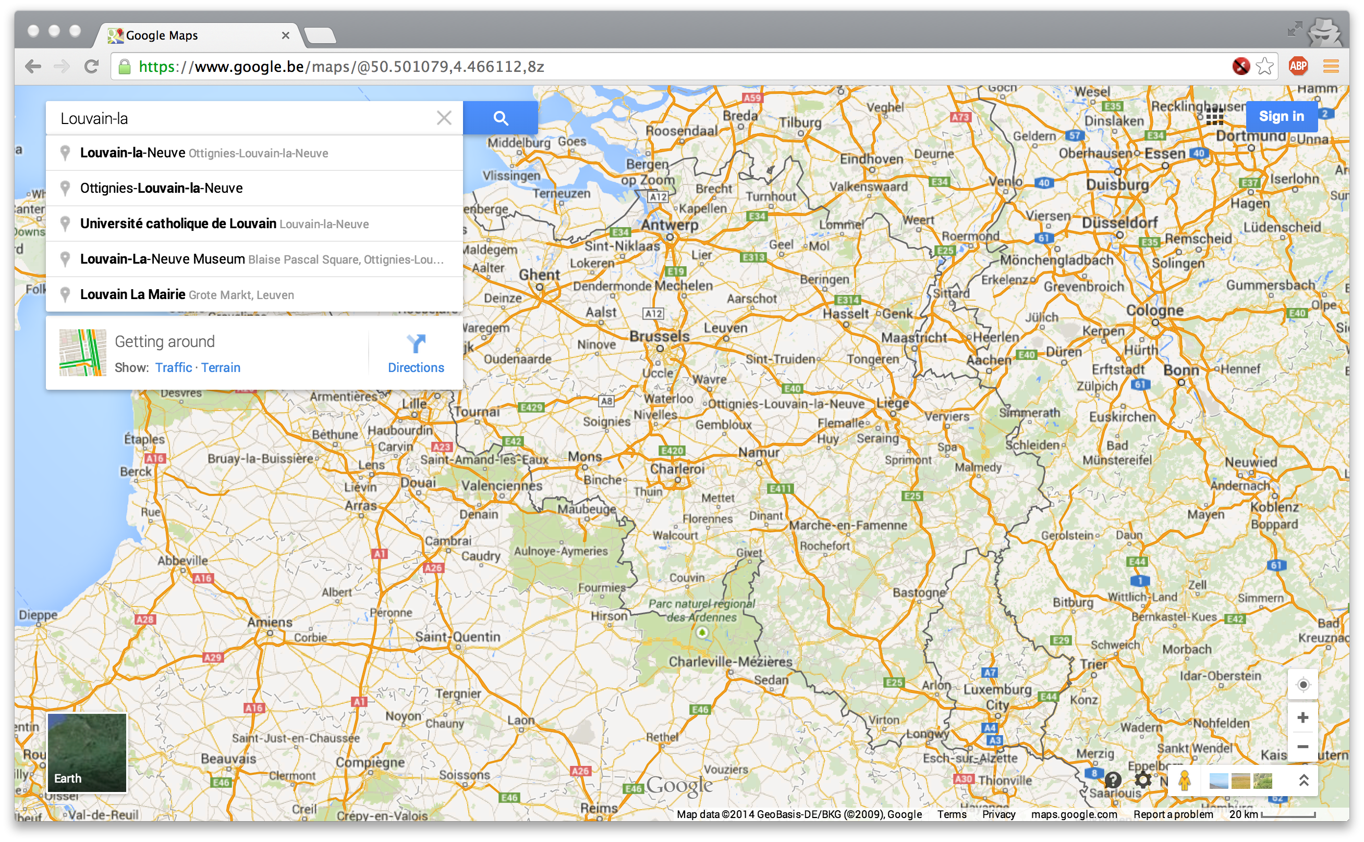
Where is AJAX used?
Widely used by many Web applications today
Examples: Google Maps, Gmail, Search Suggestions, ...

Slide 28
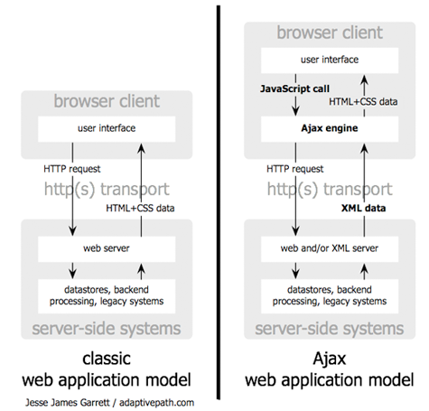
How does AJAX work?
http://www.adaptivepath.com/images/publications/essays/ajax-fig1_small.png

Slide 29
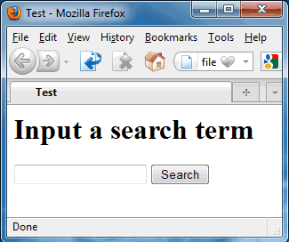



Building Web applications with AJAX
Host page
app.js
Internet
Node
Server
Browser
function updateSuggestions() {
var term = document.getElementById('abc').value;
request = new XMLHttpRequest();
request.open("GET", "http://localhost:8080/ajaxdemo/suggest/?t="+escape(term));
request.onreadystatechange = function() {
if ((request.readyState == 4) && (request.status == 200)) {
var xmldoc = request.responseXML;
var root = xmldoc.getElementsByTagName('root').item(0);
var elements = root.getElementsByTagName('element');
var htmlOut = (elements.length)+ " suggestion(s):<br><br>";
for (var i=0; i<elements.length; i++)
htmlOut += "#"+(1+i)+": "+elements.item(i).textContent+"<br>";
document.getElementById('xyz').innerHTML = htmlOut;
}
}
request.send();
}
Several puzzle pieces are needed
Host page: A web page that we'd like to make interactive
Client-side script: A JavaScript program that
registers handlers for relevant events, such as inputs or mouse clicks
requests additional data from the server using XMLHttpRequest objects
integrates the responses with the web page using the DOM
Server side: Another JavaScript program that supplies the data
Example: Given a partial search term, return XML with suggestions
Client-side script runs in browser, server-side in Node!
JavaScript program

Slide 30
AJAX with XML
Despite its name, XMLHttpRequest can handle content other than XML
Server must set Content-Type header appropriately: text/xml for XML; text/plain or text/html otherwise
XML content can be accessed through responseXML field
DOM has the same methods as the HTML DOM
Upload data to the server as XML?
Possible, but a lot of work (server may not have a DOM)
Due to length restrictions, POST pretty much only option
Need to setRequestHeader("Content-Type", "text/xml")

Slide 31
Example: Server side
Example output:
<?xml version="1.0" ?> <root> <element>Anaconda</element> <element>Ant</element> <element>Anteater</element> <element>Antelope</element> </root>
var express = require('express');
var bodyParser = require('body-parser');
var serveStatic = require('serve-static');
var app = express();
app.use(bodyParser.urlencoded({ extended: true }));
app.use(serveStatic(__dirname + "/public",{maxAge:1}));
var terms = ["Aardvark", "Adelie penguin", "Alligator", "Alpaca", "Anaconda",
"Ant", "Anteater", "Antelope", "Ape", "Arctic seal", "Armadillo",
"Ass", "Axolotl" ];
app.get('/suggest/:term', function(req, res) {
console.log('Requested term: ' + req.params.term);
res.type('text/xml');
var response = "<?xml version=\"1.0\"?>\n<root>\n";
terms.forEach(function(t) {
if (t.substring(0, req.params.term.length) == req.params.term)
response = response + " <element>"+t+"</element>\n";
});
response = response + "</root>";
res.send(response);
});
app.listen(8080);
console.log('Server running on port 8080');

Slide 32
Example: Client side
<html>
<head><title>Test</title></head>
<script type="text/javascript">
<!--
function updateSuggestions() {
var term = document.getElementById('abc').value;
request = new XMLHttpRequest();
request.open("GET", "http://localhost:8080/suggest/"+escape(term));
request.onreadystatechange = function() {
if ((request.readyState == 4) && (request.status == 200)) {
var xmldoc = request.responseXML;
var root = xmldoc.getElementsByTagName('root').item(0);
var elements = root.getElementsByTagName('element');
var htmlOut = (elements.length)+ " suggestion(s):<br><br>";
for (var i=0; i<elements.length; i++)
htmlOut += "#"+(1+i)+": "+elements.item(i).textContent+"<br>";
document.getElementById('xyz').innerHTML = htmlOut;
}
}
request.send();
} // -->
</script>
<body>
<h1>Input a search term</h1>
<form action="" method="" onSubmit="return false">
<input type="text" name="thetext" size="20" id="abc" onKeyUp="updateSuggestions()">
<input type="submit" value="Replace">
</form>
<div id="xyz">(this is where the text will go)</div>
</body>
</html>
URL of server-side component (servlet)
Get data from XML
Callback function
Put data into page via DOM
Registers event handler

Slide 33
Some common problems
Problem: Request is never sent
Are you following the same-origin policy?
To debug, use try-catch block (as in java) and call alert() to display the exception in a dialog box, or open the browser's 'error console' window
Problem: Response is never received
Did you use the XMLHttpRequest object to issue another request in the meantime? (causes response to be lost)
Solution: Create multiple request objects
Problem: Request is only sent once
If using GET, maybe the browser has cached the response?
Solution #1: Append a nonce to the URL, e.g., current time
Solution #2: Use POST instead of GET

Slide 34
Pros and cons of AJAX
Much more responsive than plain HTML
Can avoid wide-area latency in many cases (why not all?)
Faster - can transfer just the required information after each interaction, rather than the entire page (+less bandwidth)
Difficult to integrate navigation elements
'Back' button, bookmarks, external links from other pages etc. require special care (window.location.hash)
Difficult to accommodate search engines
Need to use site maps or carefully construct initial page
JavaScript compatibility issues
Messy to develop and debug
Mix of different technologies; lack of tool support

Slide 35
Recap: AJAX
A mix of several technologies
"Asynchronous JavaScript and XML"
Can be used to build interactive web pages
HTML and CSS for rendering the host page
JavaScript event handlers for responding to inputs
XMLHttpRequest object for getting more data from server
XML, HTML, text or JSON for encoding the responses
DOM for integrating data with the host page
Other techniques are sometimes mentioned, e.g., XSLT

Slide 36
Goals for today
Brief introduction to JavaScript
Event handlers
Accessing the DOM
The XMLHttpRequest object
AJAX
Putting everything together
Example: Search suggestions
Simplifying things
jQuery support for AJAX
JSON
Using external elements
Example: Google Maps
NEXT

Slide 37
AJAX troubles
"I don't want to write all that code for packing and unpacking XML"
"I don't want to deal with XMLHttpRequest objects directly"
"There are still browser incompatibilities?!?"
Stay tuned...

Slide 38
jQuery support for AJAX
<html><head>
<script src="http://ajax.googleapis.com/ajax/libs/jquery/1.11.1/jquery.min.js"> </script><script>
$(document).ready(function(){
$("button").click(function(){
$("#div1").load("demo_test.txt",function(responseTxt,statusTxt,xhr){
if (statusTxt=="success")
alert("External content loaded successfully!");
if (statusTxt=="error")
alert("Error: "+xhr.status+": "+xhr.statusText);
});
});
});
</script></head><body>
<div id="div1"><h2>Let jQuery AJAX Change This Text</h2></div>
<button>Get External Content</button>
</body></html>
http://www.w3schools.com/jquery/jquery_ajax_load.asp
jQuery makes AJAX much more convenient
Transparently handles browser incompatibilities
Comes with convenience methods like $("#someid").load(...)
No need to deal with XMLHttpRequest directly

Slide 39
jQuery support for AJAX
http://www.w3schools.com/jquery/jquery_ajax_get_post.asp
$("button").click(function(){ $.get("/someURL",function(d,s){ alert("Data: " + d + "\nStatus: " + s); }); });
$("button").click(function(){ $.post("/someOtherURL", { name:"Donald Duck", city:"Duckburg" }, function(data,status){ alert("Data: " + data + "\nStatus: " + status); }); });
Direct support for GET and POST requests
GET: Simply specify URL to get + callback
POST: Can additionally specify data to post
Much more convenient!!

Slide 40
Problem: Sending structured data
{ "firstName": "John", "lastName": "Smith", "age": 25, "address": { "streetAddress": "21 2nd Street", "city": "New York",
"state": "NY",
"postalCode": 10021 },
"phoneNumber": [
{ "type": "home", "number": "212 555-1234" },
{ "type": "fax", "number": "646 555-4567" } ] }
What if we want the server to return an object, or an array, or ...?
Use JSON!

Slide 41
Working with JSON
On the client side:
Invoke $.getJSON('/url', function(data)) instead of $.get
When the server returns JSON-encoded data, it is parsed (via eval()) and returned as an object
Warning: Security implications!
On the server side:
Step 1: In the route callback, build the object to return
Step 2: Send with res.send(JSON.stringify(yourObject))
Object will be JSON-encoded and sent back to the client

Slide 42
AJAX with jQuery/JSON: Server side
var express = require('express');
var bodyParser = require('body-parser');
var serveStatic = require('serve-static');
var app = express();
app.use(bodyParser.urlencoded({ extended: true }));
app.use(serveStatic(__dirname + "/public",{maxAge:1}));
var terms = ["Aardvark", "Adelie penguin", "Alligator", "Alpaca", "Anaconda",
"Ant", "Anteater", "Antelope", "Ape", "Arctic seal", "Armadillo",
"Ass", "Axolotl" ];
app.get('/suggest/:term', function(req, res) {
console.log('requested term: ' + req.params.term);
var response = [];
terms.forEach(function(t) {
if (t.substring(0, req.params.term.length) == req.params.term)
response.push(t);
});
res.send(JSON.stringify(response));
});
app.listen(8080);
console.log('Server running on port 8080');

Slide 43
AJAX with jQuery/JSON: Client side
<html>
<head><title>Test</title></head>
<script src="//ajax.googleapis.com/ajax/libs/jquery/1.11.1/jquery.min.js"></script>
<script type="text/javascript">
<!--
function updateSugg() {
var term = document.getElementById('abc').value;
$.getJSON('http://localhost:8080/suggest/'+escape(term), function(elements) {
var htmlOut = (elements.length)+ " suggestion(s):<p><table border=\"1\">\n";
for (var i=0; i<elements.length; i++)
htmlOut += "<tr><td>#"+(1+i)+"</td><td>"+elements[i]+"</td></tr>\n";
htmlOut += "</table>\n";
$("#xyz").html(htmlOut);
});
} // -->
</script>
<body>
<h1>Input a search term</h1>
<form action="" method="" onSubmit="return false">
<input type="text" name="thetext" size="20" id="abc" onKeyUp="updateSugg()">
<input type="submit" value="Replace">
</form>
<div id="xyz">(this is where the text will go)</div>
</body>
</html>

Slide 44
Refreshing data
<html>
<head><title>Timeout</title>
<script src="http://ajax.googleapis.com/ajax/libs/jquery/1.11.1/jquery.min.js"> </script><script type="text/javascript">
var refreshTime = function() {
$("#clock").html((new Date()).toString());
setTimeout(refreshTime, 1000); /* 1000 ms */
};
$(document).ready(function() {
setTimeout(refreshTime, 1000); /* 1000 ms */
});
</script>
</head><body><div id="clock">(Time goes here)</div></body></html>
What if something on your page should refresh periodically?
Example: Chat server; local window should display new chat messages soon after remote users have posted them
Solution: Timeouts
Could fire off an AJAX request to ask server for updates

Slide 45
Goals for today
Brief introduction to JavaScript
Event handlers
Accessing the DOM
The XMLHttpRequest object
AJAX
Putting everything together
Example: Search suggestions
Simplifying things
jQuery support for AJAX
JSON
Using external elements
Example: Google Maps
NEXT

Slide 46
Working with APIs: Google Maps
Pages often incorporate elements from other pages through APIs
Example: Google Maps
You can:
Draw various kinds of maps
Create markers & associate them with pop-up boxes
And many more things
For more information:
https://developers.google.com/maps/documentation/javascript/

Slide 47
Google Maps: Creating a map
<html>
<head><title>Map</title>
<script src="http://maps.google.com/maps/api/js?sensor=true"></script>
<script src="//ajax.googleapis.com/ajax/libs/jquery/1.11.1/jquery.min.js"> </script><script type="text/javascript">
var map;
var loadMap = function() {
var myOptions = {
center: { lat:50.668, lng:4.622 },
zoom: 11
};
map = new google.maps.Map(document.getElementById("map"), myOptions);
};
window.onload = function() { loadMap(); }
</script>
</head><body>
<div id="map" style="width:500px;height:500px;"></div>
</body></html>
Can use onLoad function to instantiate map
This function is executed as soon as the page loads
Can give parameters to customize map

Slide 48
Google Maps: Event handlers
How can we tell when the user interacts with the map?
Solution: Install event handlers!
Example: Get position after left click
Add a listener for the 'click' event on your map
Callback will receive an object that describes the event
This object contains, e.g., the latitude and the longitude
google.maps.event.addListener(map, "click", function( event ){
$("#pos").innerHTML = 'Lat: ' + event.latLng.lat() + ', lon: ' + event.latLng.lng();
} );
...
<div id="pos"></div>

Slide 49

Google Maps: Installing markers
var myPos = new google.maps.LatLng(50.668, 4.622);
var marker = new google.maps.Marker({ position: myPos, draggable:false
});
marker.setMap(map);
marker['infowindow'] = new google.maps.InfoWindow({
content: "This is a test"
});
google.maps.event.addListener(marker, 'click', function() {
this['infowindow'].open(map, this);
});
You can create 'markers' ( ) on the map
Markers, too, can have event handlers
Example: Pop up a little window when some clicks on marker

Slide 50
Resources
W3Schools tutorial
http://www.w3schools.com/js/
Covers the basics (use the navbar on the left!)
Express tutorial
http://net.tutsplus.com/tutorials/javascript-ajax/introduction-to-express/
JQuery tutorial
http://www.w3schools.com/jquery/jquery_intro.asp
http://learn.jquery.com/
AWS JavaScript API reference
http://aws.amazon.com/documentation/sdk-for-javascript/

